Slide 1
Minimum Viable Product Demo:
ASSERT (AI-Supported Smart Electricity Restoration Tool )
Team iCons (UMass Amherst)
Anvitha, Gabby, Jose, Kushagra, Sarojini, Suhani

Slide 2
End Users — Utility Emergency Response Teams (UERTs)
Damage Assessment
John Burnap of Eversource, MA and Michael Gibeley of National Grid [MA/RI/NY]
Factors considered when making decisions about restoration*:
Type, availability, proximity of resources
Specialized equipment
Consequence of delay
Number of customers affected
Factors missing: social vulnerabilities
Prioritization of Repairs
Tactical Restoration
* Eversource Emergency Response Plan Electric (MA)

Slide 3
Thank You to the User Advocates We Spoke With!
Carol Freeman — National Preparedness Analytics Center, Argonne National Laboratory
Scott Sternfeld — The Outage Data Initiative
Hessann Farooqi — Boston Climate Action Network
Kristen Finne — Department of Health and Human Services
Jason Eisdorfer — Pacific Northwest National Lab
Todd Levin — Argonne National Laboratory

Slide 4
ASSERT Objectives
ASSERT aims to add a lens of power outage overburden and vulnerability to the utility emergency response’s repair and restoration decision-making pipeline.
Vulnerability,
Overburden
Damage Assessment
Prioritization of Repairs
Tactical Restoration
Notes:
imagine the outage has just happened
and we’re in the emergency control room
we have 10 trucks to send out? where do we send them
Currently, utility emergency response teams assess the damage during a power outage and determines which area, if restored, would get the grid back in order the quickest
Let’s say there’s a short circuit in one of the local lines, a decision needs to be made on which house gets power first. That’s where ASSERT comes in.

Slide 5
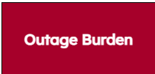
Federal Open Data Used
Social Vulnerability Index (SVI)
ODIN (Outage Data Initiative)
Correlate most significant vulnerability indicators to outage burden using Linear Regression.
<outage>_{county}— <outage>_{state}
Burden =
σ_{state}
Outage Data Initiative (ODIN)
Datasets we are using in our analysis.
Notes:
To define energy burden per county, we took the difference between average power outage duration for each county and the overall state average power outage duration and normalized it with the state’s standard deviation (a positive burden value indicates that the average power outage duration for the specific county was higher than the overall state average, and a negative value indicates that the county average was less than the state average
With the ODIN dataset we are using power outage duration, and we use the Social Vulnerability Index dataset to help estimate power burden
We saw a correlation between power outage duration and these indices which we will show in the next few slides

Slide 6
ASSERT Brain
Identified key metrics that predict power overburden in counties lacking data.
Using unemployment, poverty and minority data to predict power overburden
Notes:
Let’s take a look at what makes assert work. To make it work, we identified key metrics that predict power overburden in counties lacking data; that is, counties that don’t have enough power outage duration data to draw conclusions about their power burden. These key metrics, unemployment, poverty and minority data, are used to predict power overburden

Slide 7
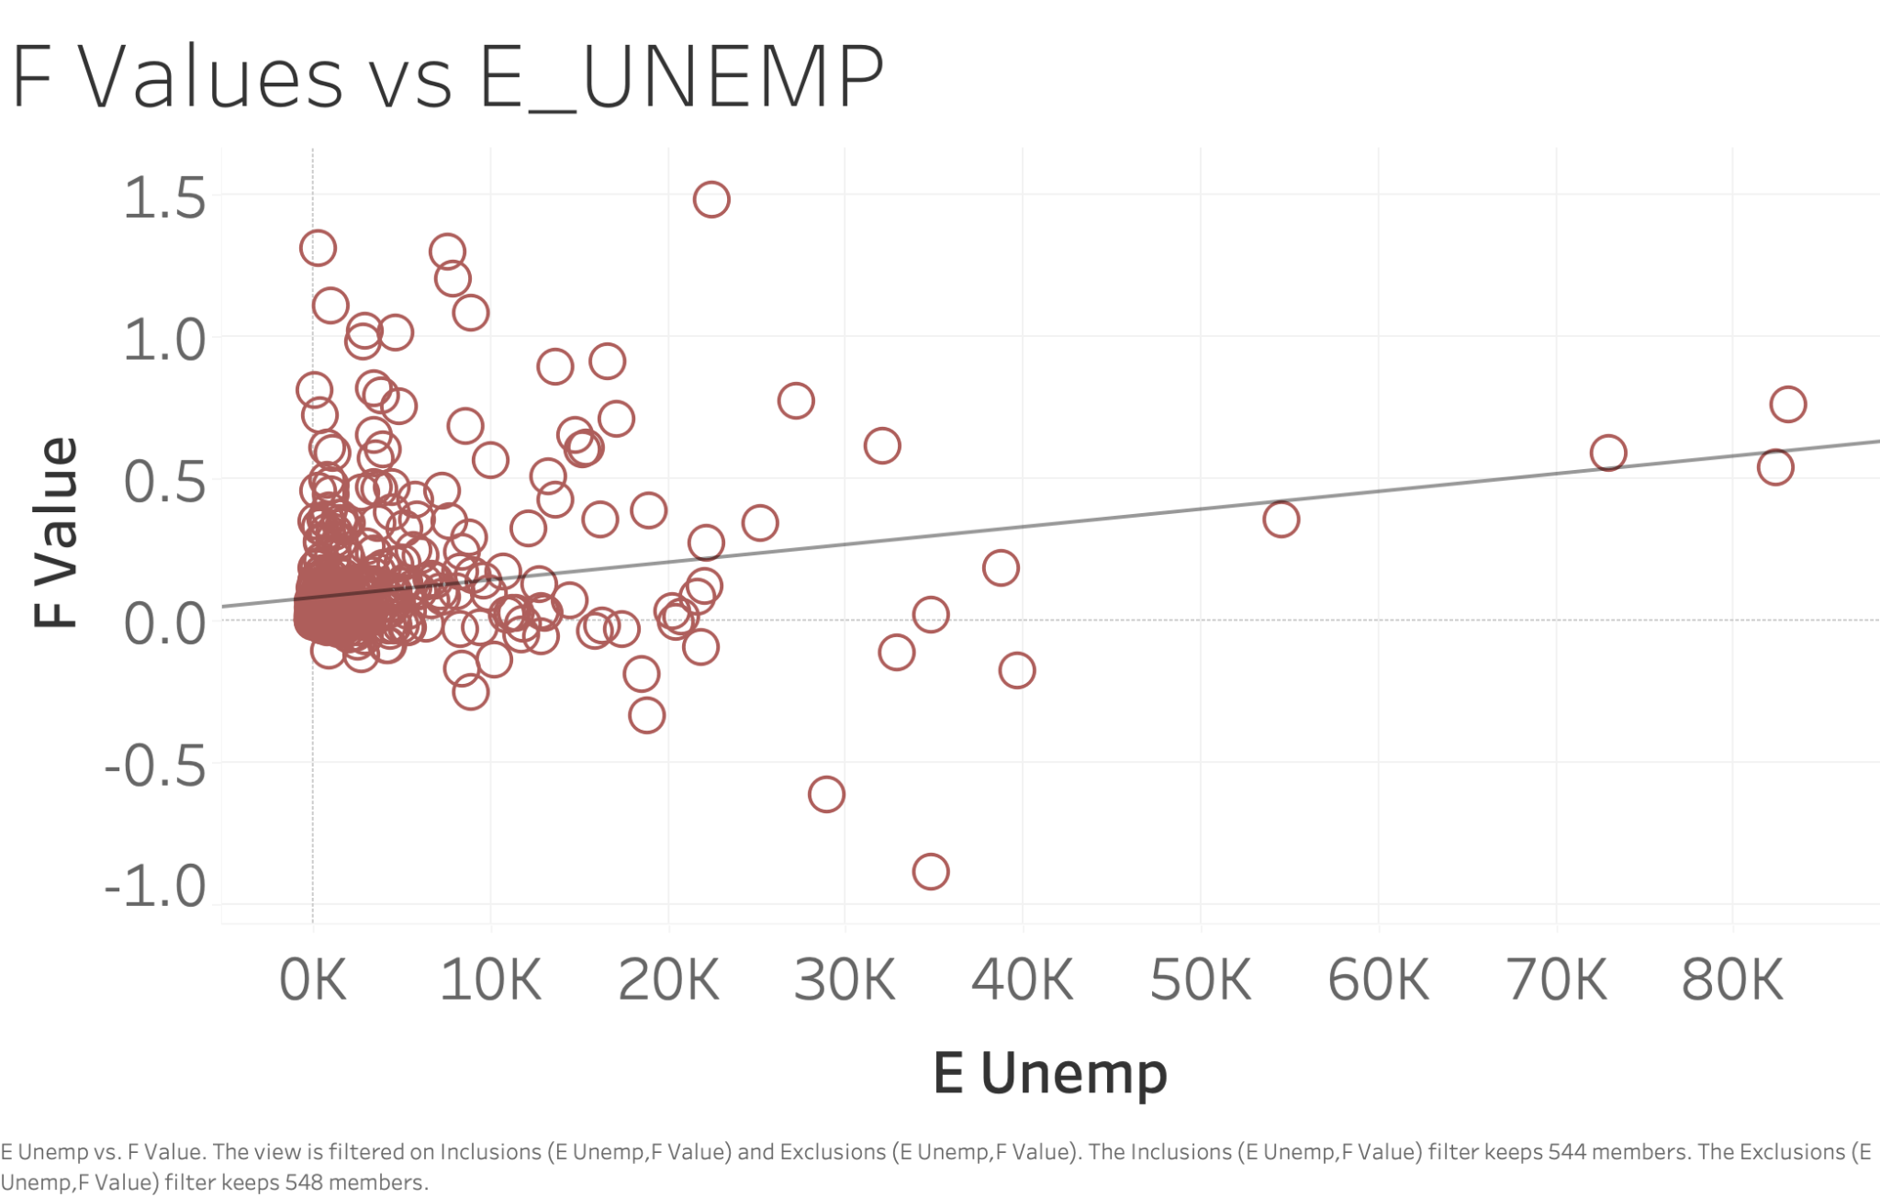
ASSERT Brain – Continued
Notes:
Here is one of the factors we identified to be the most relevant, and thus included in our analysis of power overburden. Y axis is F-value, our measure of overburden, and x axis is estimated unemployed civilians in a county. By performing analises in this fashion, and using other statistical tools, we narrowed down on the most relevant factors to our prediction and selected them for ASSERT’s model.

Slide 8
Key Metrics for Measuring Impact
Users can describe the extent to which ASSERT fulfils these metrics:
Ease of use
Clear purpose
Aids in deploying resources in areas with little information
Rapid dissemination of predicted/actual outage burden information

Slide 9
Deployment/Implementation Plan
We performed a PCA to extract the key factors for
Selecting method of forming predictions based on factors from PCA
Linear Regression
Leaflet GIS tool
Static site using GitHub Pages
Translating wireframe to site aesthetics

Slide 10
Product
Demo
Live unveiling of ASSERT!
suobset.github.io/assert

Slide 11
Summary and Next Big Steps
Summary:
ASSERT creates a model for predicting the extent to which counties are overburdened by power outages
Aimed to aid utility emergency planning pipeline.
Next Big Steps:
Consult with our Target Users [John Burnap of Eversource and Michael Gibeley of National Grid]
Expand features and analysis in parallel with ODIN expansion.

Slide 12



Thanks for listening! Questions?
Thank you to

